Slide 1
Java persistence api
ORM

Slide 2
JPA javax.persistence
Added in JEE5 as JPA 1.0
JEE7 uses JPA2.1
Its an abstract over JDBC which shield us from dealing with SQL
Main components:
ORM
Entity Manager API for CRUD operations
JPQL – Object Oriented Query Language
Tx and locking mechanisms (JTA - Java Tx API)
Call Backs and Listeners for attaching business logic to events

Slide 3
JPA persistent objects
Persistent objects are object that can store their data permanently (DB).
JPA is an ORM framework that maps data in a bidirectional fashion, that is objects to tables and tables to objects.
Objects persist in memory only.
Entity is used to refer to Objects that can Persist to a database.
Once entities are mapped then can be managed by JPM and can be removed, updated and query using JPQL.
JPManager allows you to manipulate entities while the database is accessed under the hood.
An entity follows a life cycle with call-backs hooks and listeners that lets you attach business code to life cycle events.

Slide 4
JPA entities in persistence model (ORM)
An entity is a PoJo that is:
Declared, instantiated and used (call methods).
Has attributes, setters and getters
Has a default (no-arg) constructor
Annotated with @Entity which allows the persistent provider to recognize it as a persistence class (not PoJo)
@Id defines the unique identifier (Primary Key).
An entity class must be top-level class(not abstract or interface)
The entity class must be final (No methods or persistence instance variables can be final)
Must implement Serializable interface

Slide 5
JPA annotations - configuration-by-exception
Using annotations we can map entity-to-table and table-to-entity
These annotations are associated with every Entity (described in javax.persistence) and they are metadata and these metadata info can be written in:
Annotations @Entity, @Table, @column, @Id, etc. OR/AND
XML Descriptors – the xml file will have the mapping rules
JPA uses the configuration-by-exception (conventions-over-configurations or program-by-exceptions) programming style (JEE5) where by JPA uses default mapping rules unless the rules are overwritten using annotations(or XML):
@Entity - maps the entity into a table with the same as the class name (all caps) to override this default use @Table(name=“new_table_name”)
Each Column name is named after the attribute of the class with caps(isbn ➔ ISBN) to override use @Column (name=“new_column_name”)
Datatypes are mapped accordingly (String ➔ varchar)

Slide 6
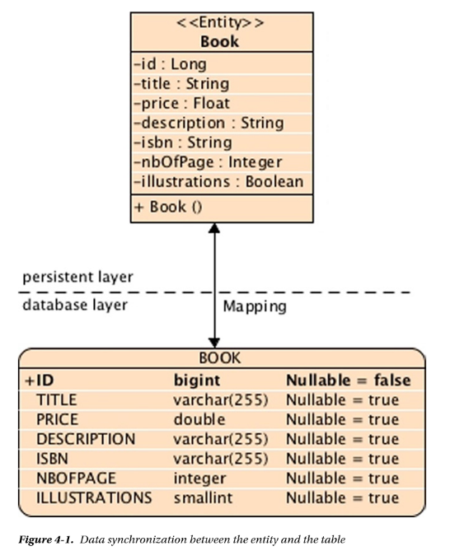
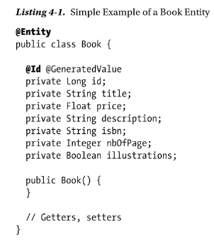
JPA annotations - configuration-by-exception
Default Mapping Rules or override with annotation

Slide 7
JPA querying entities steps
STEP 1: Instantiate an EntityManager object type: EntityManagerFactory emf = Persistence.createEntityManager(“chapter04PU”); EntityManager em = emf.createEntityManager();
STEP 2: create an instance of Transaction: EntityTransaction tx = em.getTransaction(); tx.begin();
STEP 2: create an instance of the Entity and persist using the EntityManager object: Book book = new Book(1001, “my Book”, …); em.persist(book); tx.commit(); //commit trasnaction
Execute the named query
Close the em and emf. em.close(); emf.close();

Slide 8
JPA EntityManager interface
Obtained using factory see previous example
Provides a set of methods that can allows CRUD operations on Entity
When you invoke the EntityManager methods, the persistence provider generates and executes the SQL statement through JDBC.

Slide 9
JPA persist entities
EntityManager Interface:
Obtained using factory see previous example
Provides a set of methods that can allows CRUD operations on Entity
When you invoke the EntityManager methods, the persistence provider generates and executes the SQL statement through JDBC.
<<interface>>
<<EntityManager>>
persist(Entity: Object): void
Find(identifyClass: Class<T>, PrimaryKey: Ob ject) : <T>
DB
Client Main
<<Entity>>
<<Book>>
id: Long
title: String …

Slide 10
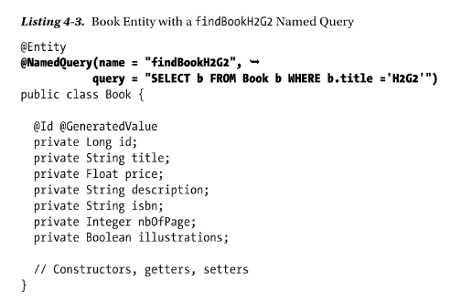
JPA JPQL – Entity Query
JPA use JPQL to query the database (similar to SQL)
SELECT b FROM Book WHERE b.title=“JEE7”; //b.title is the Book entity attribute NOT the table’s attribute
@NamedQuery defines static query to be executed later (see listing 4.3 and the dynamic version on page 108.)
In Main.java: // 4-Executes the named query book = em.createNamedQuery("findBookH2G2", Book.class).getSingleResult();

Slide 11
JPA Persistence Unit – persistence.xml
EntityManagerFactory emf = Persistence.createEntityManager(“chapter04PU”);
PU is defined in META-INF/persistence.xml
chapter04PU is the persistence unit and indicates to the EM:
Type of database (derby)
Database driver
Connection parameters(database name, id, password, port, etc.)

Slide 12
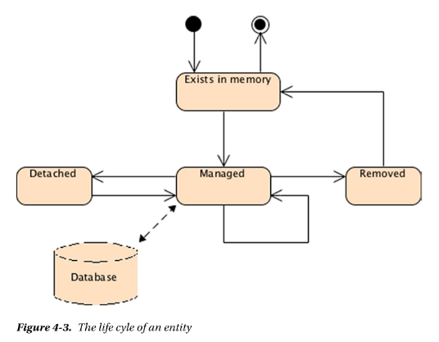
JPA entity life cycle and the call-backs
Entities are POJOs they have persistence key which is a key that identifies the instance (just like PK in tables)
When entity is created using factory or new operation
em.remove();
Removes data from DB
When entity becomes managed by EntityManager as an effect of annotations

Slide 13
JPA entity life cycle and the call-backs
Each operation (persist(), update(), remove(), load()) has a “per” and “post” events
These events can be intercepted by EnitityManager to add business logic using:
@PrePersist and @PostPersist annotations
JPS allows you to hook business code to the entity when these events are triggered.
The QprePersist and PostPersist annotation can be set on entity methods (a.k.a call back methods) or in External class (a.k.a listeners)
Analogous to triggers in RDBMS
When entity is created using factory or new operation
em.remove();
Removes data from DB
When entity becomes managed by EntityManager as an effect of annotations

Slide 14
JPA integration with Bean validation(chapter 3)
Validation annotations are automatically called by JPA and the JPA delegates validation to Bean Validation API
Upon pre-persist, pre-update, and pre-remove
OR
Call the validation manually by calling the validate() method of a validator on an Entity
See listing 4.6 page 112.

Slide 15
JPA integration with Bean validation(Example)
Book Entity
Bean Validation
Main class that persists a book
Compile with Maven
Run with EclipseLink
Derby client database (inm memory db)
Test Class (BookIT) Junit 4
src/main/Java: Book entity and Main class
src/main/resources: persistence.xml
src/test/java: BookIT class
Build and execute [pom.xml] for Maven which describes the project and its dependencies.
See Book Pages: 114 – 124

Slide 16
JPA history of JPA
ORM
EclipseLink is a heavyweight OO Persistent Model
1998 EJB 1.0 with Entity Bean (CMP)
Hibernate is a lightweight OO Persistent Model
JEE 5.0 JPA 1.0 very lightweight and adopted many Hibernate design principles
JPA 1.0 specs was bundled with EJB 3.0 (JSR220)
JPA 2.0 shipped with JEE6.0 (JSR 317) extended JPQL and added:
Scheme generation
Convertors: classes that convert database attributes
CDI support: injection into event listeners
Bulk operations (update and delete)

Slide 17
JPA implementation: persistence providers
EclipseLink 2.5 ➔ JPA 2.1 is a heavyweight OO Persistent Model
Framework for storing Java objects in a relational model
Supports xml using Java XML Binding (JAXB)
Supports ORM
Supports Object XML Mapping (OXM)
Supports Object Persistence to Enterprise System (EIS)
Uses Java EE Connection Architecture (JCA)
Supports database web services
Hibernate is a lightweight OO Persistent Model
OpenJPA

